Slide 1
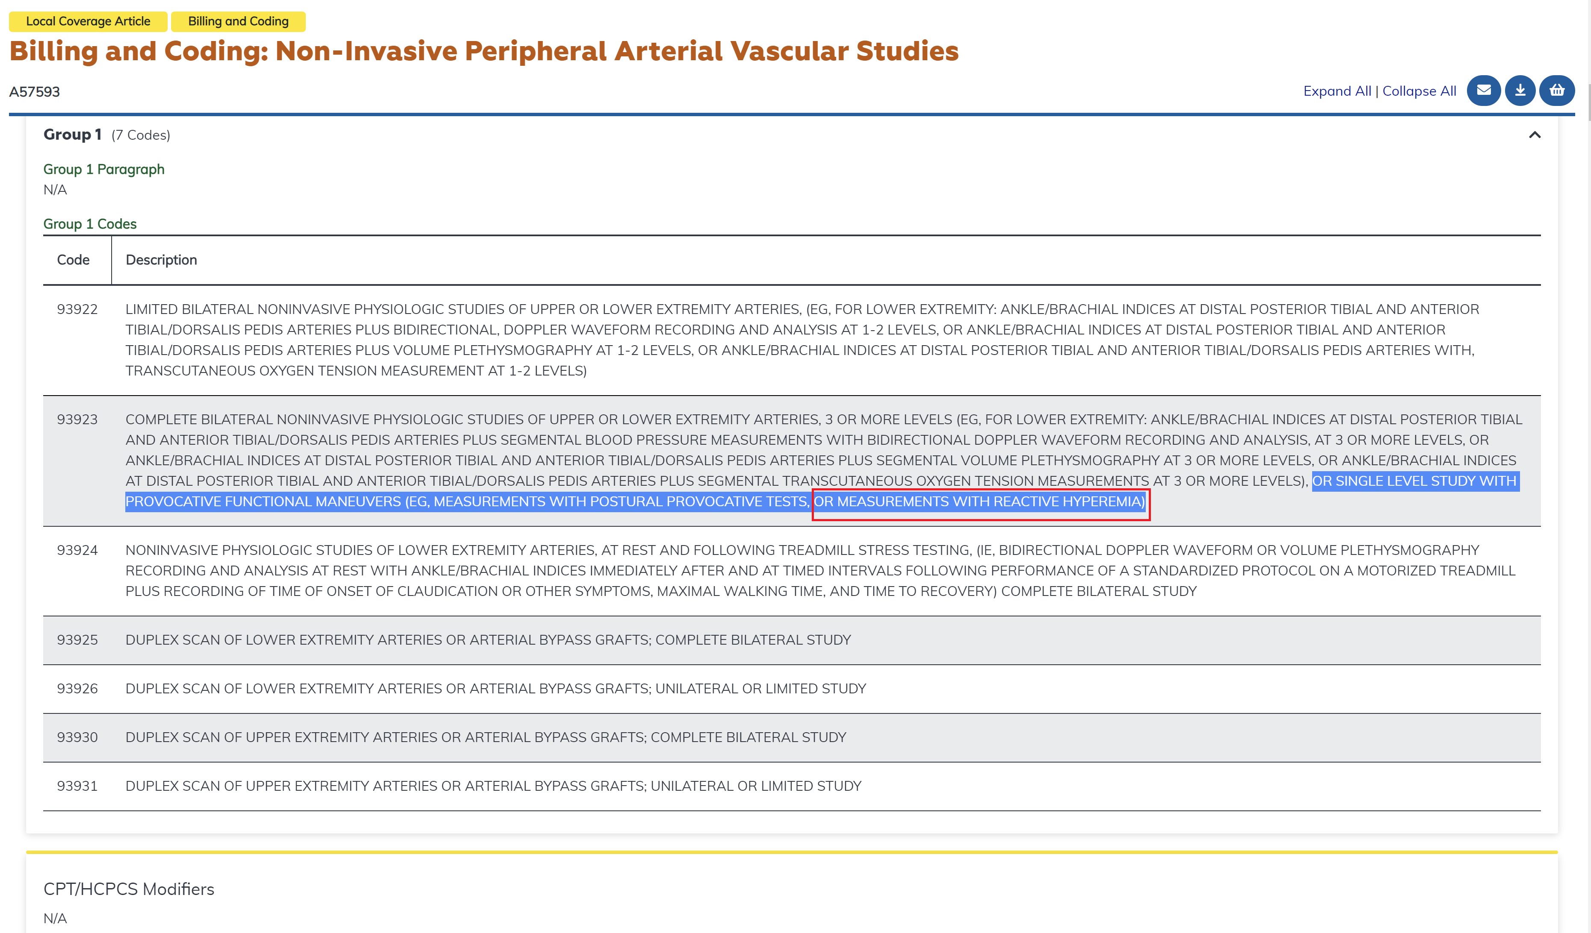
Please see the latest CMS link for ICD codes (CPT 93923, Group 1) for billing VENDYS: https://www.cms.gov/medicare-coverage-database/view/article.aspx?articleId=57593

